Slide 1
Quadriga Intro
Parallel Wireless
September 2025

Slide 2
What is QuaDRiGa?
QuaDRiGa = QUAsi Deterministic Radio channel Generator
Geometry-based stochastic channel model (GSCM)
Based on WINNER II, extended for massive MIMO and mmWave
Supports multi-link, multi-band, multi-antenna, and mobility
Widely used in 5G/6G research

Slide 3
Key Feature: Spatial Consistency
Ensures smooth channel transitions as a UE moves
Maintains consistent angles, delays, and powers across space
Enables realistic handover and beam tracking
Supports correlated channels for nearby users

Slide 4
Environments & Scenarios in QuaDRiGa
Urban Macro (UMa) – large towers, NLOS common
Urban Micro (UMi) – dense city, strong multipath
Indoor Office – walls, LOS/NLOS transitions
Rural Macro (RMa) – sparse scatterers, long delays
Highway / V2X – fast mobility, Doppler spread

Slide 5
Spatial Consistency Example Across Environments
Indoor Office → rich multipath, small-scale fading
Urban Street → NLOS-to-LOS transition
Open Plaza → fewer clusters, stable LOS
Vehicle (V2X) → high Doppler, fast changes
QuaDRiGa evolves clusters smoothly instead of random redraws.

Slide 6
Why Researchers Use QuaDRiGa
Validated against real-world measurements
Flexible for massive MIMO & beamforming
Captures mobility across environments with spatial consistency
Essential for studying beam tracking, handovers, MU-MIMO

Slide 7
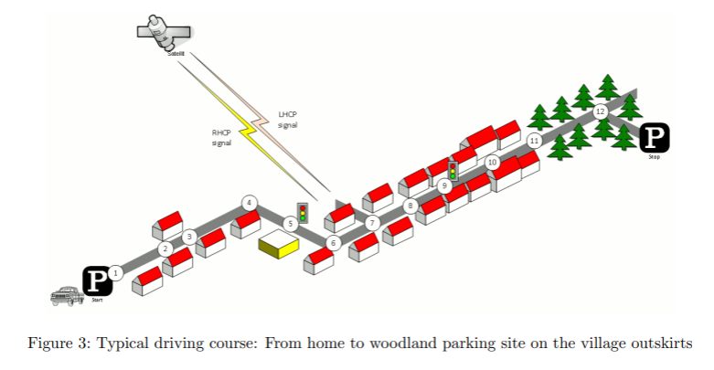
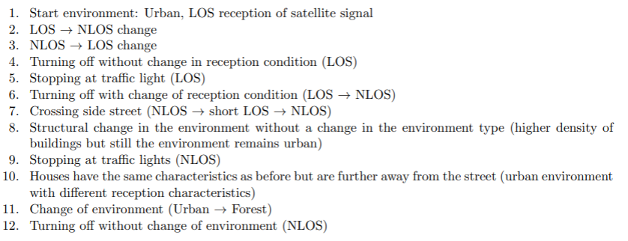
Drive Course model example

Slide 8
Quadriga Channel Model Integration in Simulator
Quadriga Configuration Overview
The simulator leverages a wide range of Quadriga parameters.
These parameters are set in the scenario settings of the simulation.
Categories include:
  Antenna parameters (array type, polarization, spacing).
  Layout parameters (deployment type, ISD, number of sectors).
  Dependent parameters inherited from the system-level simulation framework, ensuring consistency with the rest of the simulation setup.
This flexible configuration framework allows Quadriga to be tuned to different environments and system designs.

Slide 9
Channel Generation Control in Simulation Setup
The simulator setup includes specific control over Quadriga channel generation:
  Channels can be forced to regenerate at the start of each run.
  Control to save and reuse layouts or builders is available.
  Segment-based channel generation is supported, allowing channels to be recomputed for each simulation segment.
  Option to reuse the first segment’s channel across later segments to reduce memory load.
The setup also defines how channel data is stored and passed to the main simulation loop, ensuring efficient management of Quadriga out

Slide 10
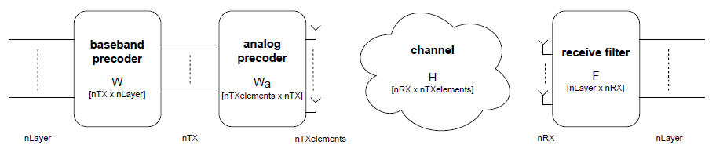
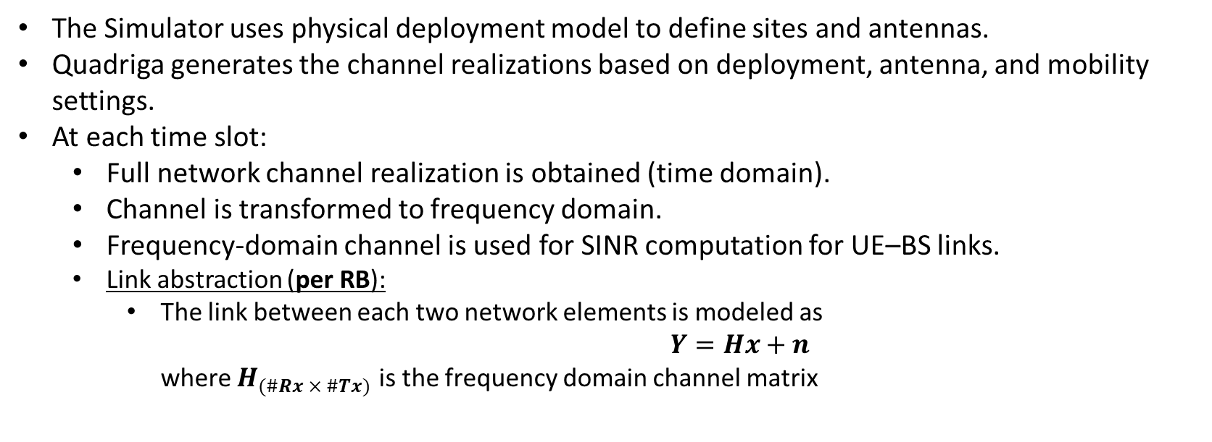
Simulation Usage
The Simulator uses physical deployment model to define sites and antennas.
Quadriga generates the channel realizations based on deployment, antenna, and mobility settings.
At each time slot:
  Full network channel realization is obtained (time domain).
  Channel is transformed to frequency domain.
  Frequency-domain channel is used for SINR computation for UE–BS links.
  Link abstraction (per RB):
    The link between each two network elements is modeled as
    $Y=Hx+n$
    where $H_{(\#Rx × \#Tx)}$ is the frequency domain channel matrix

